Slide 1
3 Axis Pin Development Update
Week #8

Slide 2
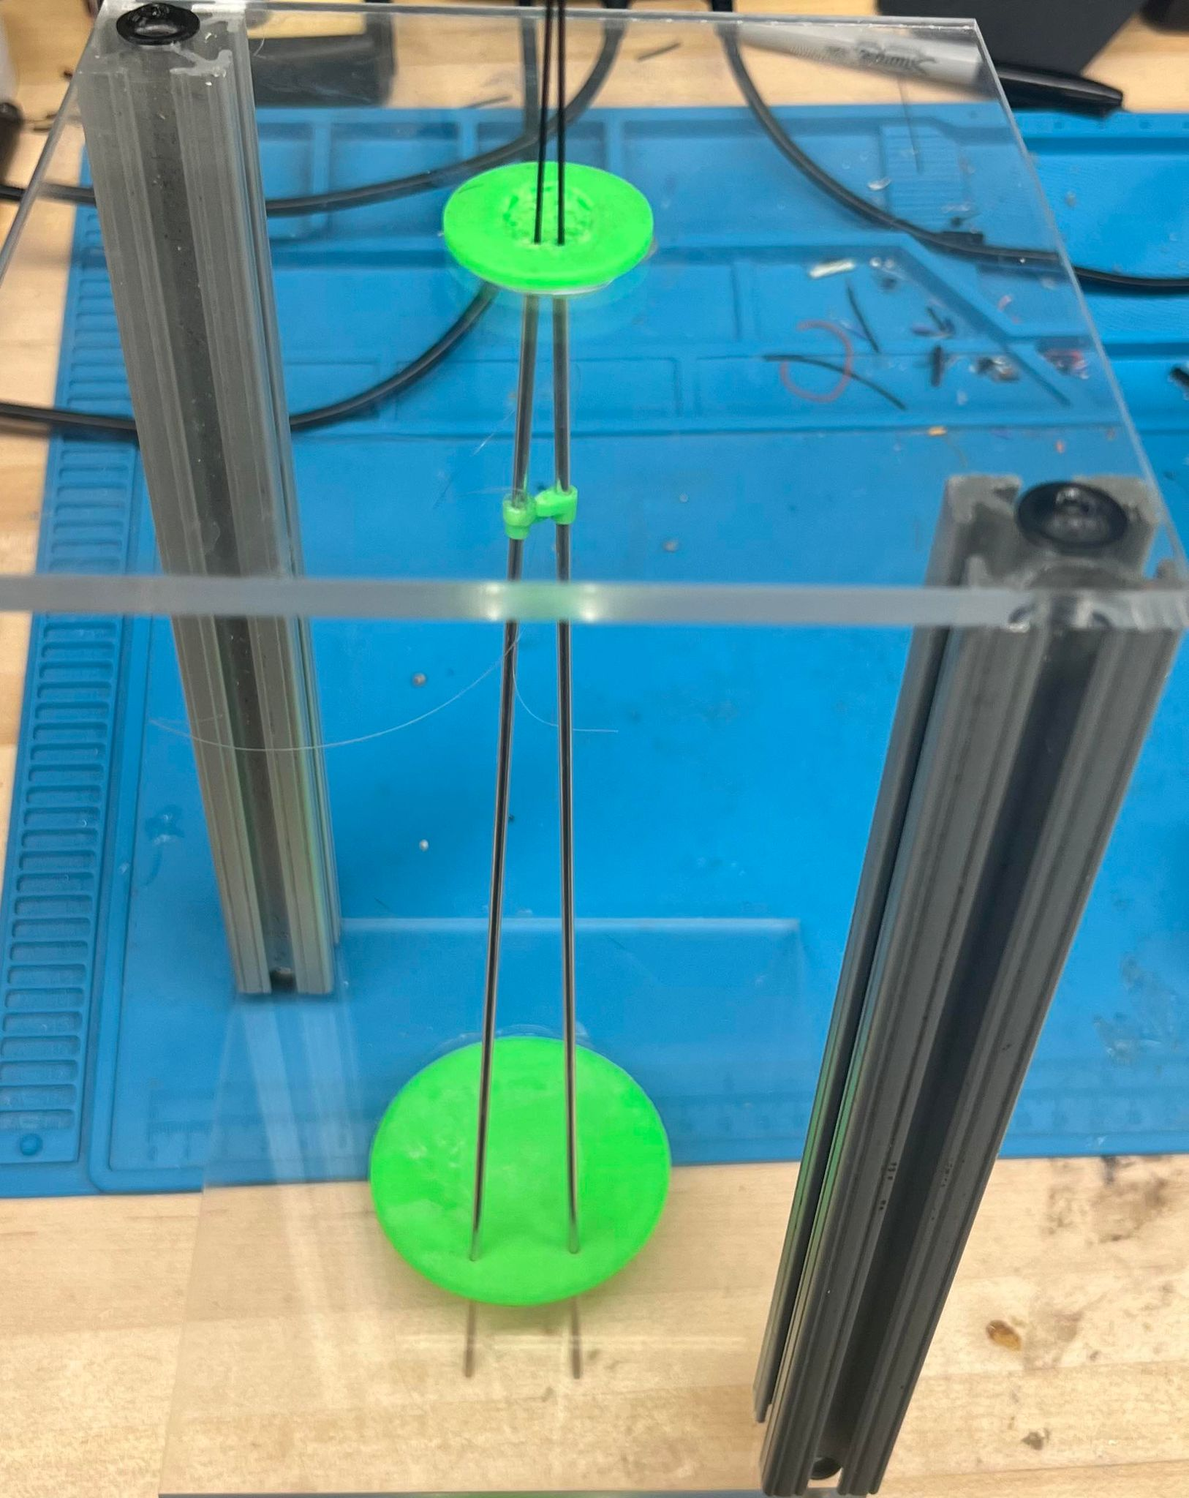
Previously On…
Pivot Point

Slide 3
Problems with Previous Designs:
Too many degrees of freedom
Pulley needs to be attached to sleeves closer to pin array pad
Rods are stiffer as D decreases

Slide 4
New Iteration

Slide 5

Pulley

Slide 6
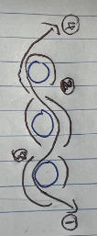
Sleeve Wrapping

Slide 7
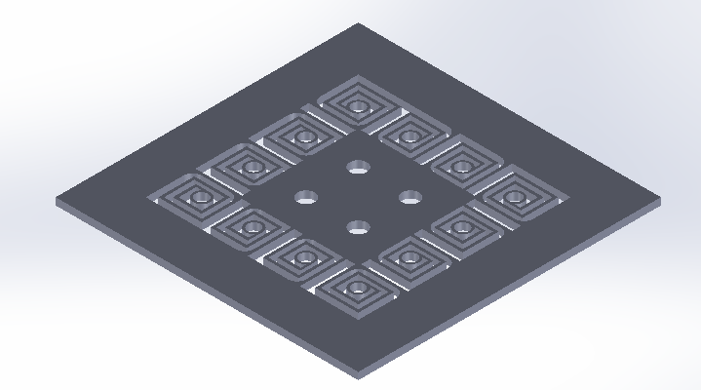
Swirly Pivot Mount

Slide 8

Attempted solution to ‘slots’ idea
Allows for independent but constrained motion of pins
Relative motion is controlled by pulley system
Requires impedance of swirl springs to be greater than that of the skin

